Slide 1

PROJECT BASED LEARNING
Page Replacement Algorithm
Operating System
CS14.351
AUTUMN SEMESTER 2019-2020
SUBMITTED TO:
MR.P.K.BISHNOI
DR. UMA KUMARI
SUBMITTED BY:
NISTHA AGARWAL (170425)
1

Slide 2
CONTENTS
Page Replacement Algorithms in Operating Systems
First In First Out (FIFO)
Optimal Page replacement
Least Recently Used

Slide 3
Page Replacement Algorithms in Operating Systems
In an operating system that uses paging for memory management, a page replacement algorithm is needed to decide which page needs to be replaced when new page comes in.
Page Fault
When we want to load the page on the memory, and the page is not stored in memory, then it is called page fault.
Page Hit
When we want to load the page on the memory, and the page is already available in memory, then it is called page hit.
Memory management unit
The run time mapping between Virtual address and Physical Address is done by hardware device known as MMU.

Slide 4
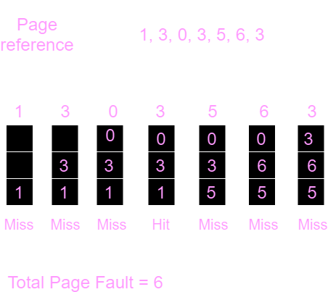
First In First Out (FIFO)
This is the simplest page replacement algorithm. In this algorithm, the operating system keeps track of all pages in the memory in a queue, the oldest page is in the front of the queue. When a page needs to be replaced page in the front of the queue is selected for removal.
Example-1: Consider page reference string 1, 3, 0, 3, 5, 6 with 3 page frames. Find number of page faults.

Slide 5
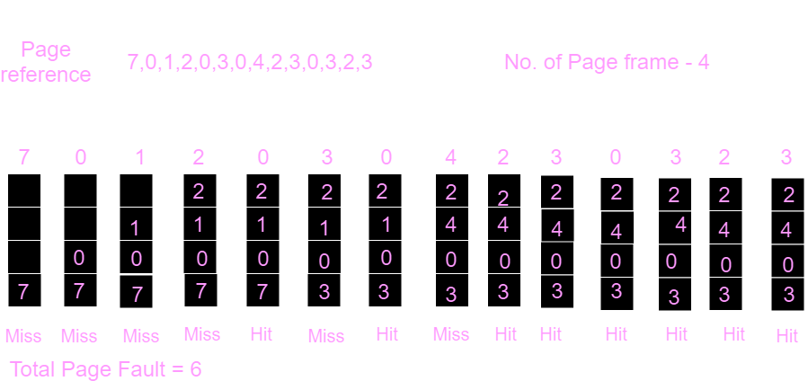
Optimal Page replacement
In this algorithm, pages are replaced which would not be used for the longest duration of time in the future.
Example-2: Consider the page references 7, 0, 1, 2, 0, 3, 0, 4, 2, 3, 0, 3, 2, with 4 page frame. Find number of page fault.

Slide 6
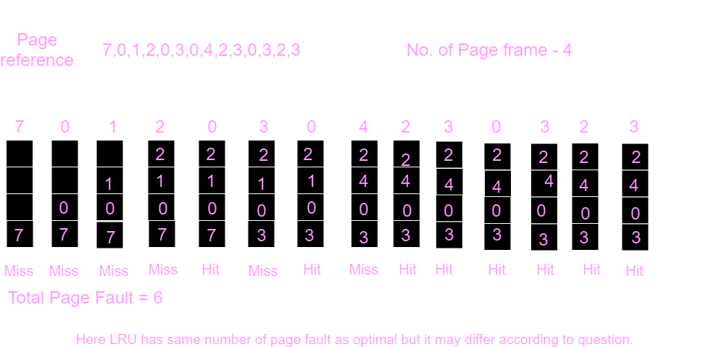
Least Recently Used
In this algorithm page will be replaced which is least recently used.
Example-3: Consider the page reference string 7, 0, 1, 2, 0, 3, 0, 4, 2, 3, 0, 3, 2 with 4 page frames. Find number of page faults.

Slide 7
Thank You!

